Slide 1
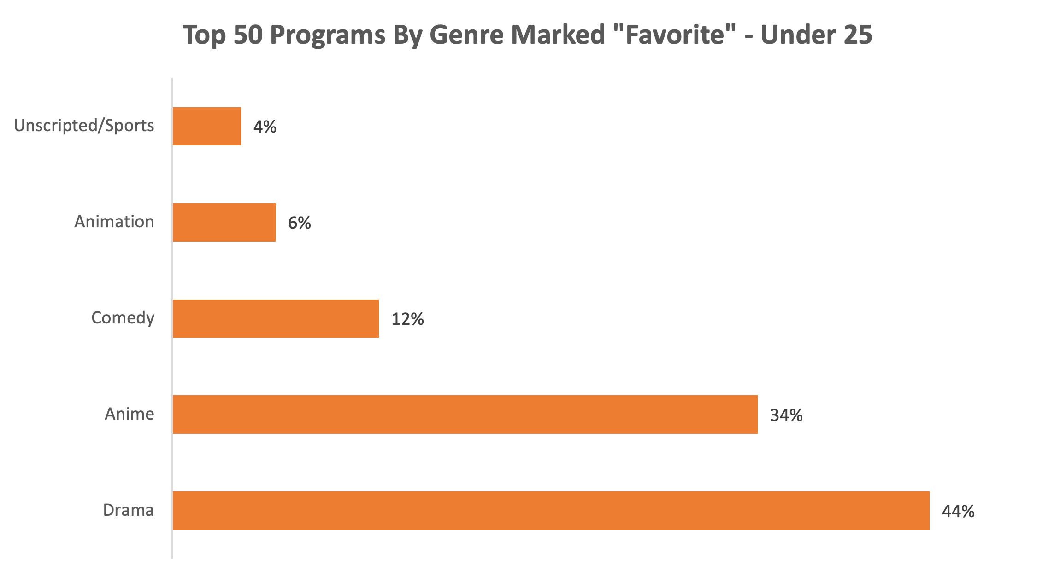
EmotionalDNA® Monthly Insight, September 2021

